Slide 1
Handwritten Digit Detection
By – Pritam Gayen

Slide 2
Presentation Outline
Introduction
Objectives
Technology Platform Overview
Implementation
Code Snapshots
Output
Applications
Future Work
Conclusion

Slide 3
INTRODUCTION
The handwritten digit recognition is the ability of computers to recognize human handwritten digits. It is a hard task for the machine because handwritten digits are not perfect and can be made with many different flavors. The handwritten digit recognition is the solution to this problem which uses the image of a digit and recognizes the digit present in the image.

Slide 4
About Deep Learning Project
In this project, we are going to implement a handwritten digit recognition app using the MNIST dataset. We will be using a special type of deep neural network that is Convolutional Neural Networks. In the end, we are going to build a GUI in which you can draw the digit and recognize it straight away.

Slide 5
OBJECTIVES OF THE PROJECT
The aim of this project is to implement a classification algorithm to recognize handwritten digits (0- 9). It has been shown in pattern recognition that no single classifier performs the best for all pattern classification problems consistently.

Slide 6
TECHNOLOGY PLATFORM OVERVIEW
The interesting Python project requires you to have basic knowledge of Python programming, deep learning with Keras library and the Tkinter library for building GUI.
Install the necessary libraries for this project using this command:
Command : pip install numpy, tensorflow, keras, pillow
The MNIST dataset
This is probably one of the most popular datasets among machine learning and deep learning enthusiasts. The MNIST dataset contains 60,000 training images of handwritten digits from zero to nine and 10,000 images for testing. So, the MNIST dataset has 10 different classes. The handwritten digits images are represented as a 28×28 matrix where each cell contains grayscale pixel value.

Slide 7
IMPLEMENTATION
Import the libraries and load the dataset
Preprocess the data
Create the model
Train the model
Evaluate the model
Create GUI to predict digits

Slide 8
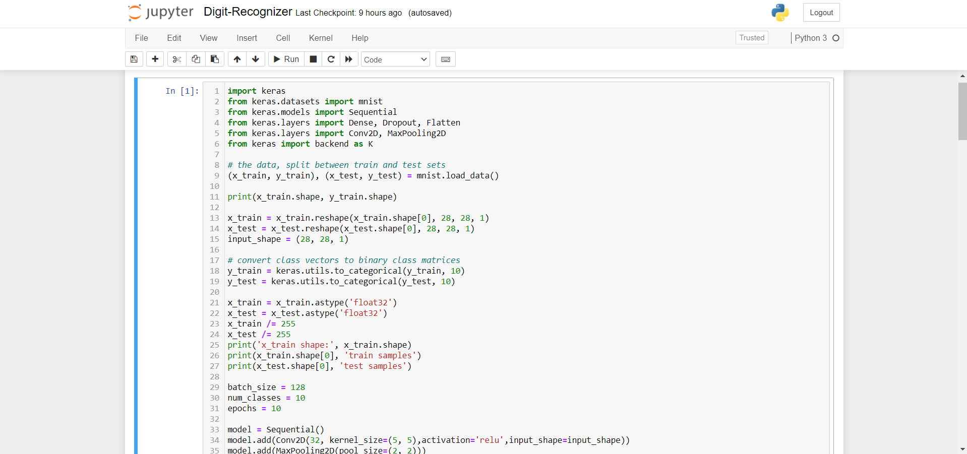
Code Snapshots

Slide 9
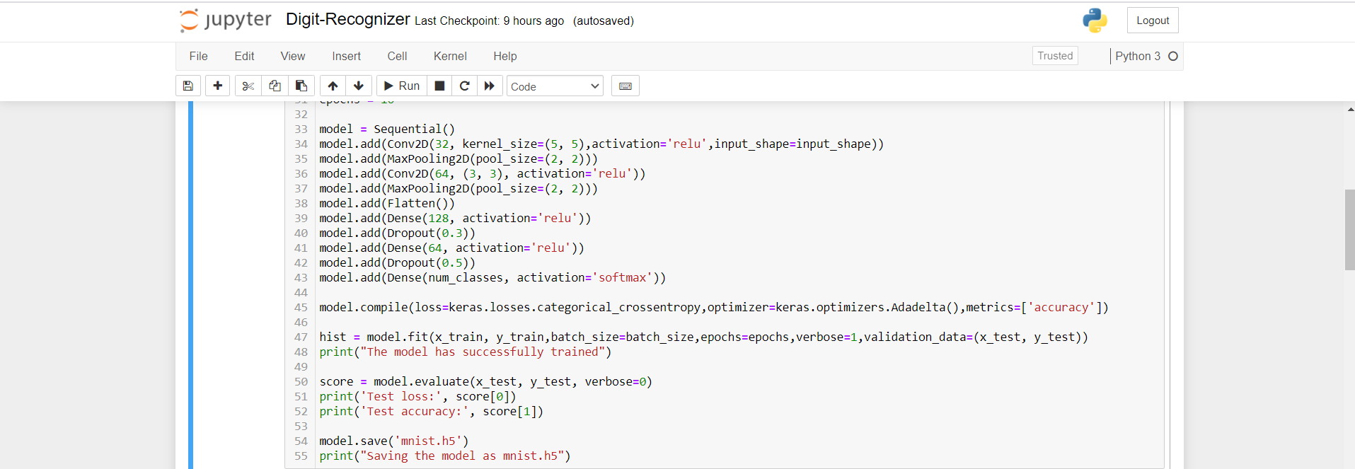

Slide 10
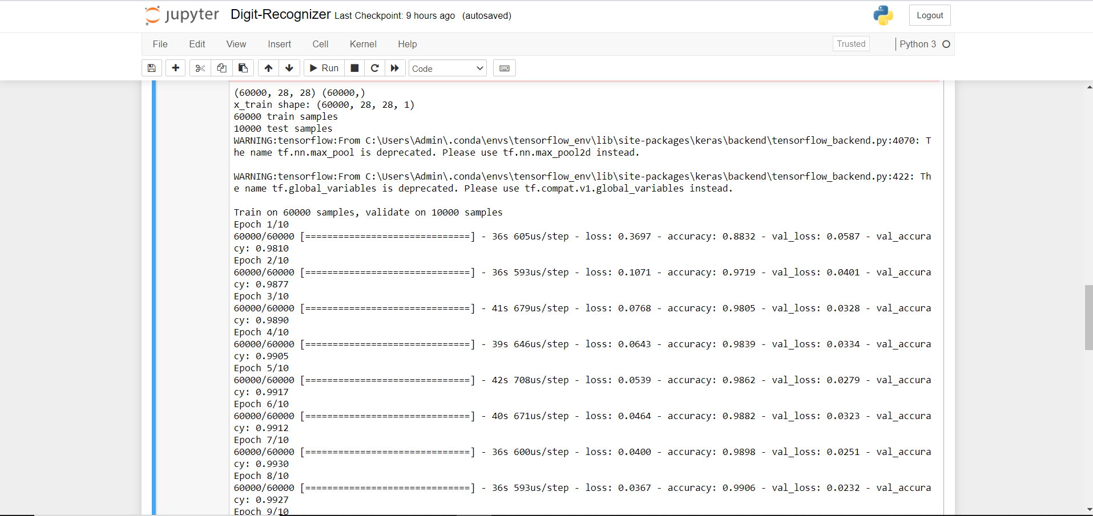

Slide 11
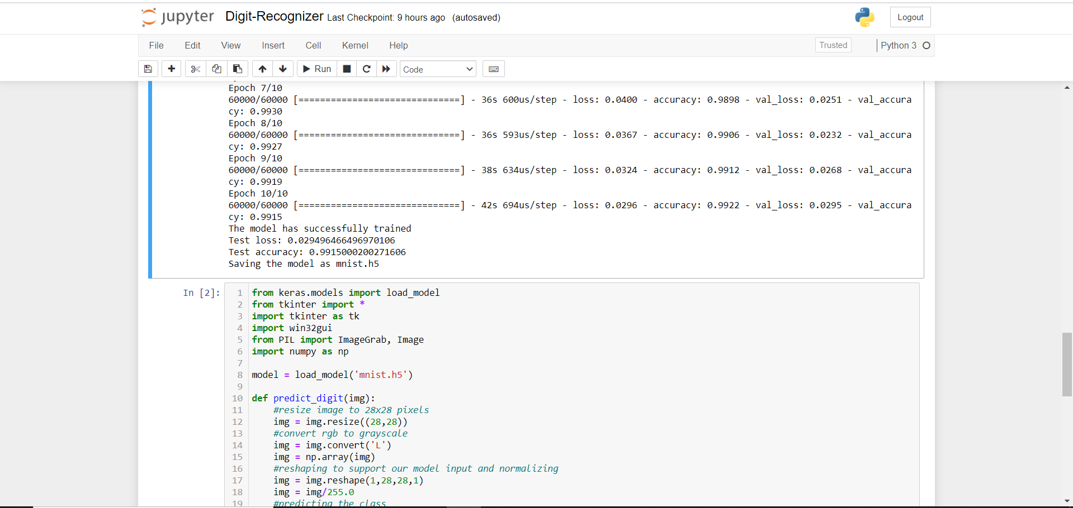

Slide 12
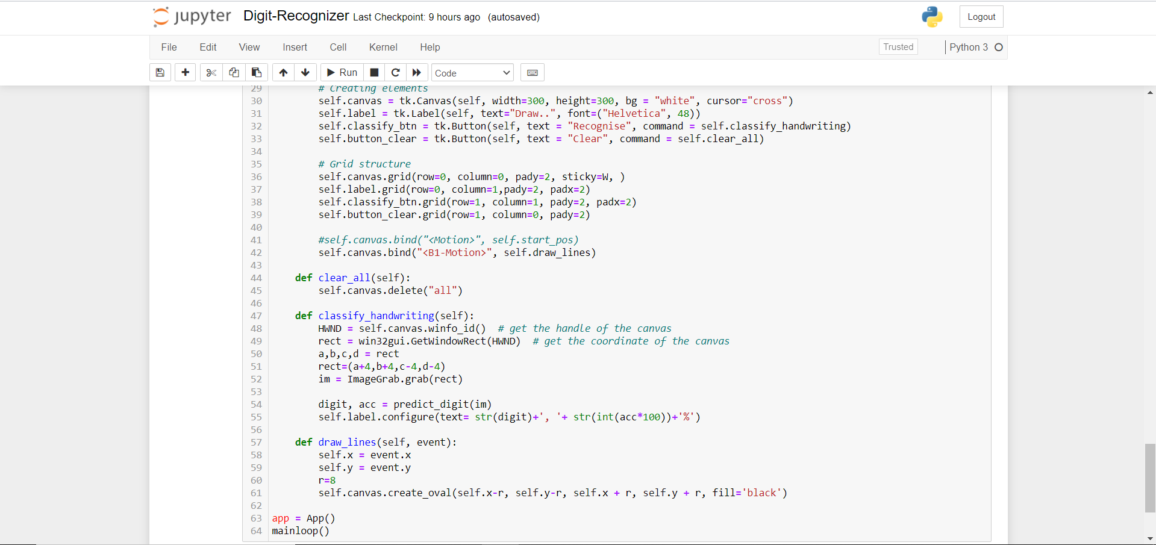

Slide 13
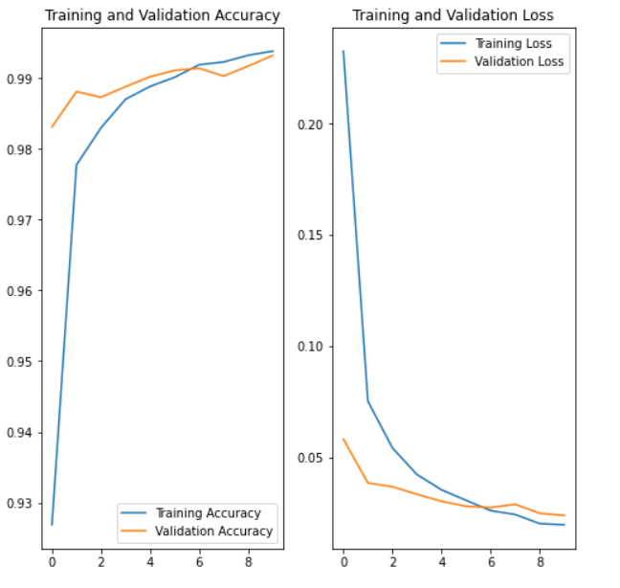

Slide 14
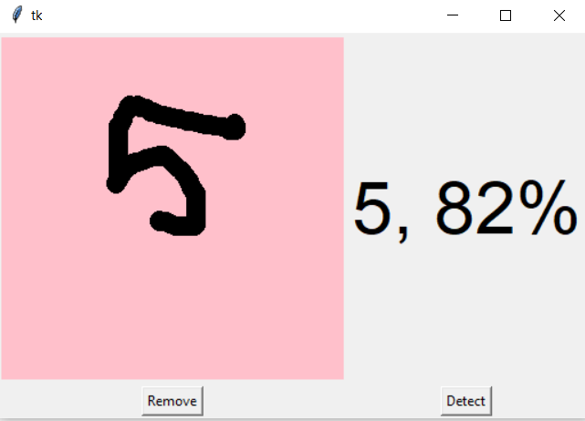
Output

Slide 15
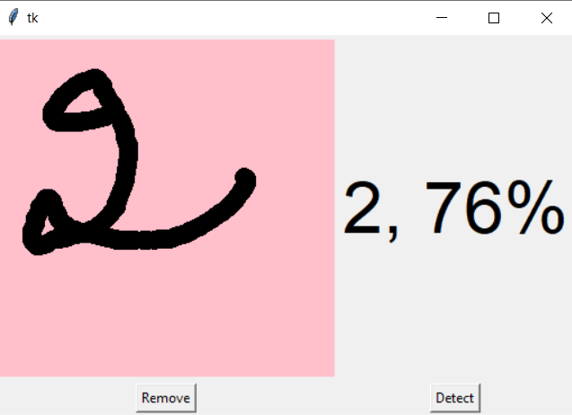

Slide 16
Applications
The applications of digit recognition includes in postal mail sorting, bank check processing, form data entry, etc.

Slide 17
FUTURE WORK
I want to add this project with the Character Detection project and try to build a better reorganization interface to detect the perfect character or digit. And also try to make an app to find the perfect match.

Slide 18
CONCLUSION
In this project, we have successfully built a Python deep learning project on handwritten digit recognition interface. We have built and trained the Convolutional neural network which is very effective for image classification purposes. Later on, we build the GUI where we draw a digit on the canvas then we classify the digit and show the results.

Slide 19
Thank You

